Slide 1
Best GARCH model to evaluate current volatility of indices
Hubert Ziomek
Vlad Yanenko

Slide 2
Data Taken
5 indices were used: Period used:
SP 500
DAX
FTSE 100 01/01/2015 - 18/05/2021
Nikkei 225
CAC 40

Slide 3
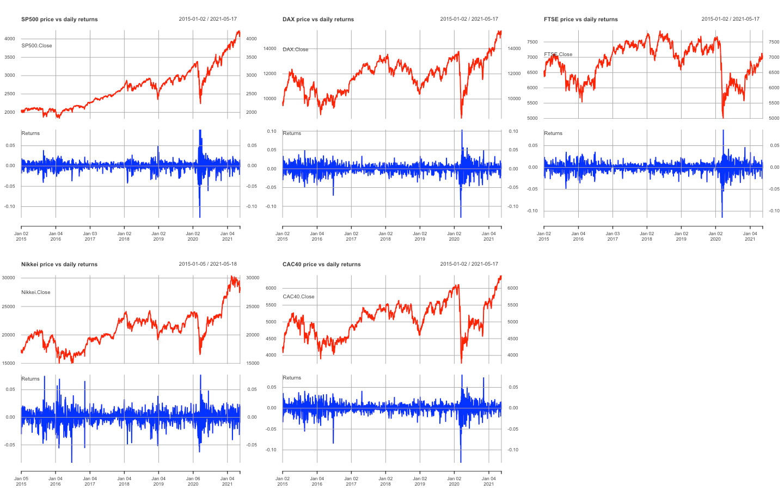
Price vs log-returns

Slide 4
Main goal and execution
Goal: To choose the best GARCH model to evaluate current volatility
Execution:
- Checking for autocorrelation in the data
- Performing ARCH effect existence
- Testing GARCH (1,1)
- Going forward with EGARCH, GARCH M, and GARCH t
- Finally choosing the best model.

Slide 5
Checking for autocorrelation
The goal of this step was to see if we can observe some autoregressive/MA relations among returns
The squared log returns were used
Intermediate Results:
Autoregression among long returns is strongly significant. It seems that ACF for square returns is decaying pretty to 0 -> evidence of autoregressive relationship

Slide 6
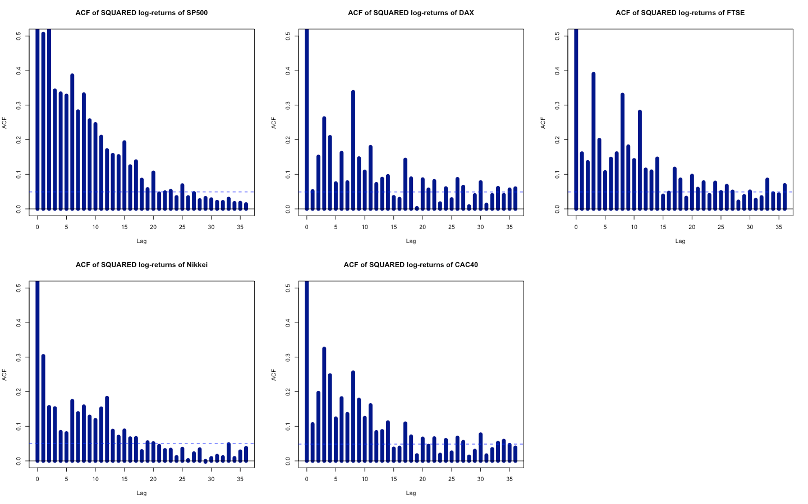

Slide 7
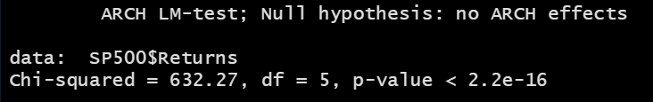
Checking for autocorrelation
Formal test ARCH effects among log-returnsusing ARCH LM-test
ARCH LM-test – formal way to test ARCH effects among log-returns.
H0 - lack of ARCH effect (autocorrelation) among squared returns
For all indices null about lack of ARCH effects was strongly rejected.
After this test, we are certain that volatility is not constant, therefore we can start to find
the best model wihich will measure the current volatility

Slide 8
GARCH(1,1)
Delivers a good fit and accurate predictions, and thanks to using one GARCH model to the five different data, we will avoid overfitting.
Ljung-Box Test:
H0- residuals are white noise / no serial correlation among the model residuals
Jarque-Bera Test:
H0 - normality distribution of residuals
Shapiro-Wilk
pretty the same, but this test isn't reliable with larger data, e.g. n > 2000

Slide 9
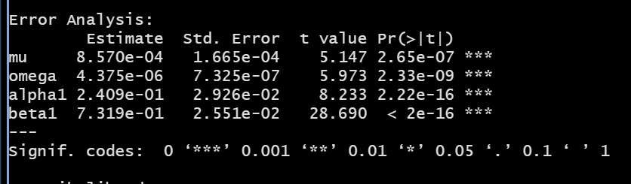
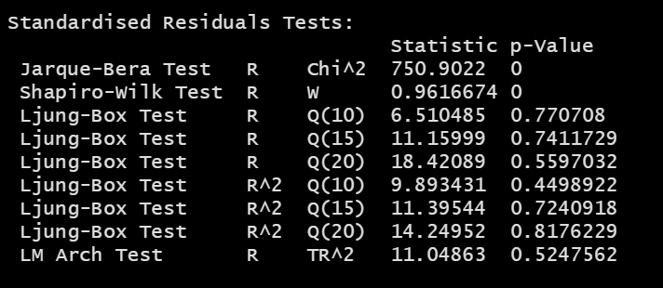
GARCH(1,1)
In most of the indices, we have found that all of the parameters were significant, and in all cases, ARCH effects were removed.

Slide 10
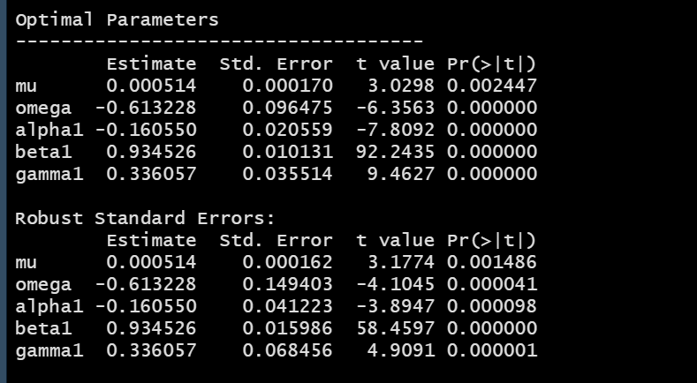
EGARCH
Checking if conditional variance reacts asymmetrically to the news arriving to the market.
Coefficient alpha1 is the assymetry term of EGARCH model (measuring the leverage effect)
It is negative and significant (<0.05) for all indices, so the asymmetry is found!

Slide 11
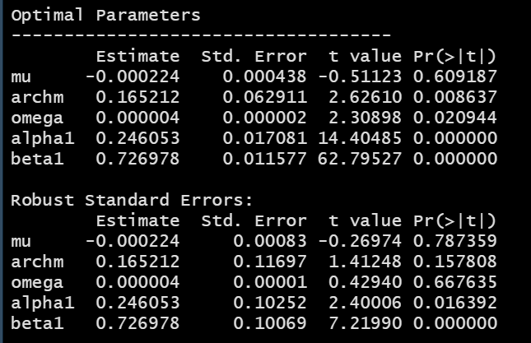
GARCH-M, GARCH-in-Mean
One expects that the higher the risk, the higher the return (on average) which is called the risk premium
The existence of risk premium is therefore confirmed if archm coefficient is significantly positive and statistically significant.
Archm coefficient is significantly positive for SP 500, DAX, CAC 40 but, when we apply robust standard errors, the archm is not statistically significant so we DO NOT find the proof for risk premium in the model.
For FTSE, Nikkei we find the proof for risk premium in the model.

Slide 12
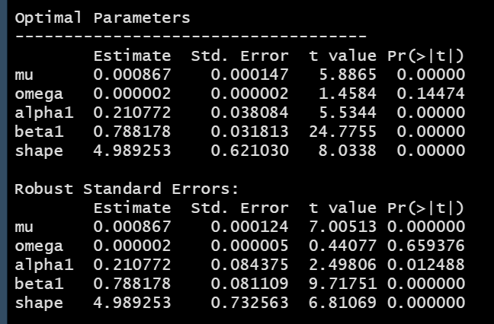
GARCH-t
t-Student distribution instead of normal distribution.
Shape is the number of degrees of freedom for the t-Student distribution.
SP 500: In our case this equals to roughly 5, so we have fatter tails than in normal distribution, and shape is statistically significant. For 6 degrees of freedom we have fatter tails than normal dist. So, t-student distribtion is better choice than normal distr.

Slide 13
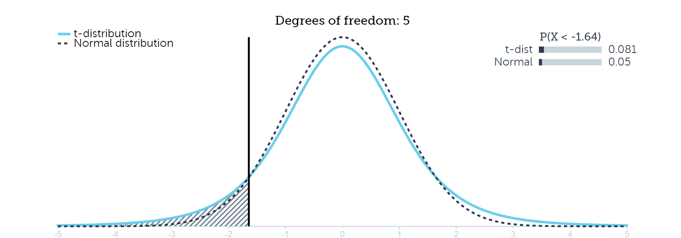
GARCH-t
DAX. Shape = 4,77, and statistically significant. So, t-student distribution is better choice than normal distr.
FTSE. Shape = 5.6, and statistically significant. So, t-student distribution is better choice than normal distr.
Nikkei. Shape = 4.4, and statistically significant. So, t-student distribtion is better choice than normal distr.
CAC 40. Shape = 4.7, and statistically significant. So, t-student distribtion is better choice than normal distr.

Slide 14
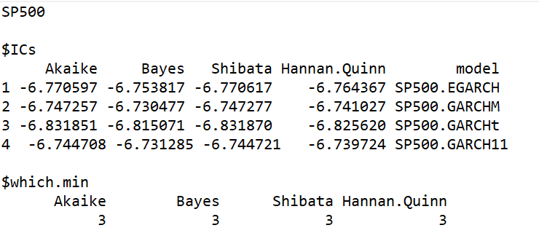
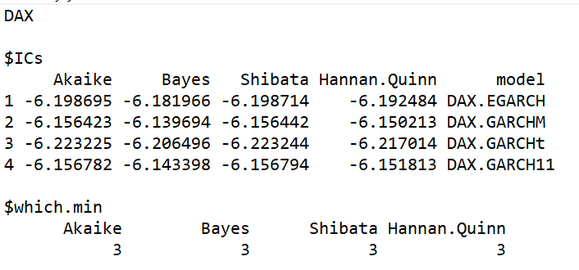
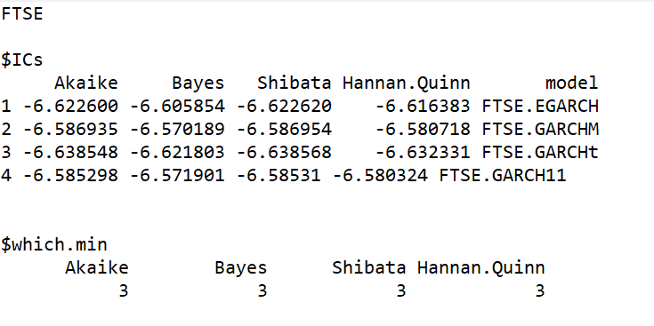
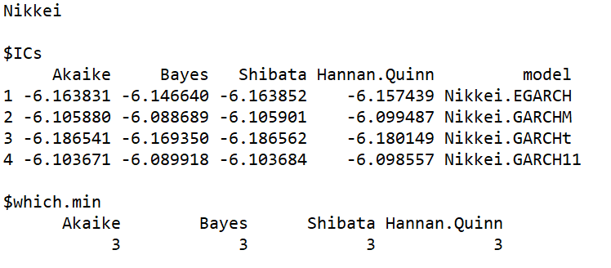
THE BEST MODEL
comparing information criteria for all models.

Slide 15
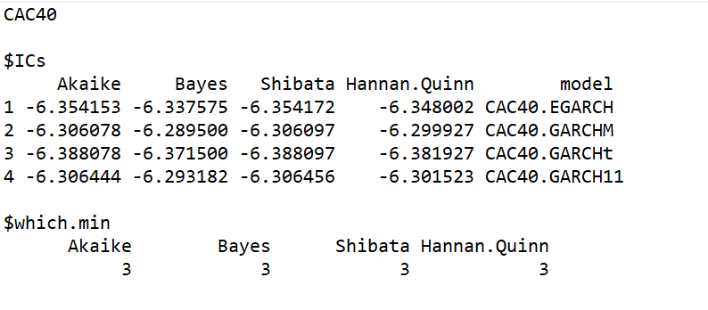
THE BEST MODEL
comparing information criteria for all models.
All criteria indicate that GARCH-t is the best (the lowest information criterion) model to evaluate current volatility

